Slide 1
DIRECT AND INDIRECT SPEECH PEL 125

Slide 2
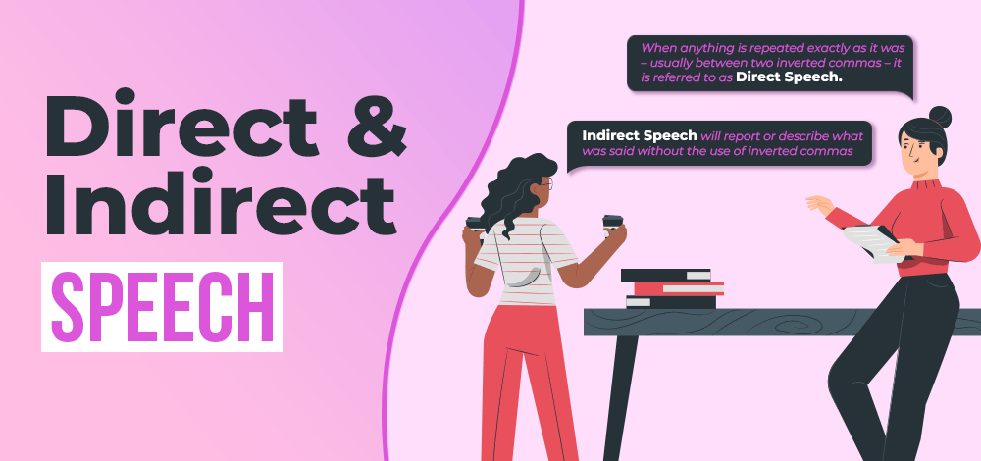

Slide 3
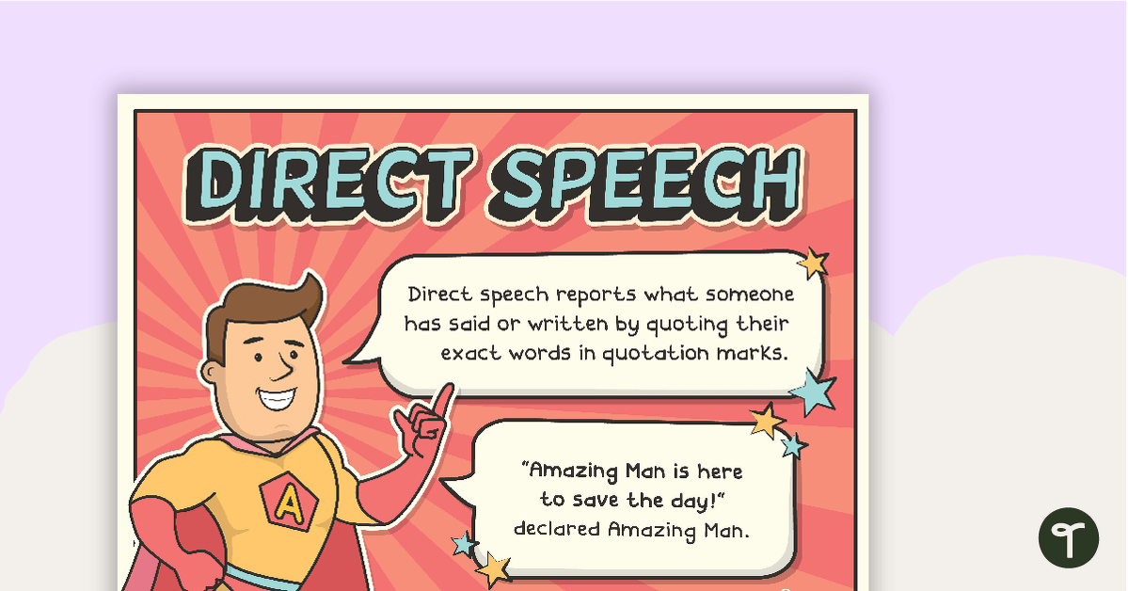

Slide 4
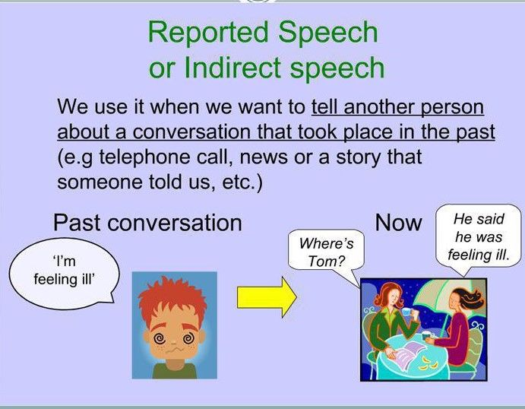

Slide 5
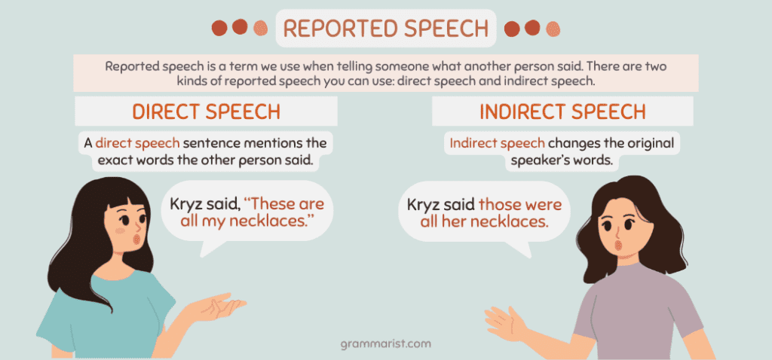

Slide 6
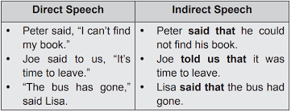

Slide 7
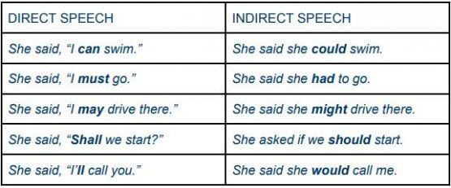

Slide 8
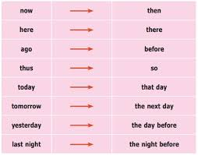

Slide 9
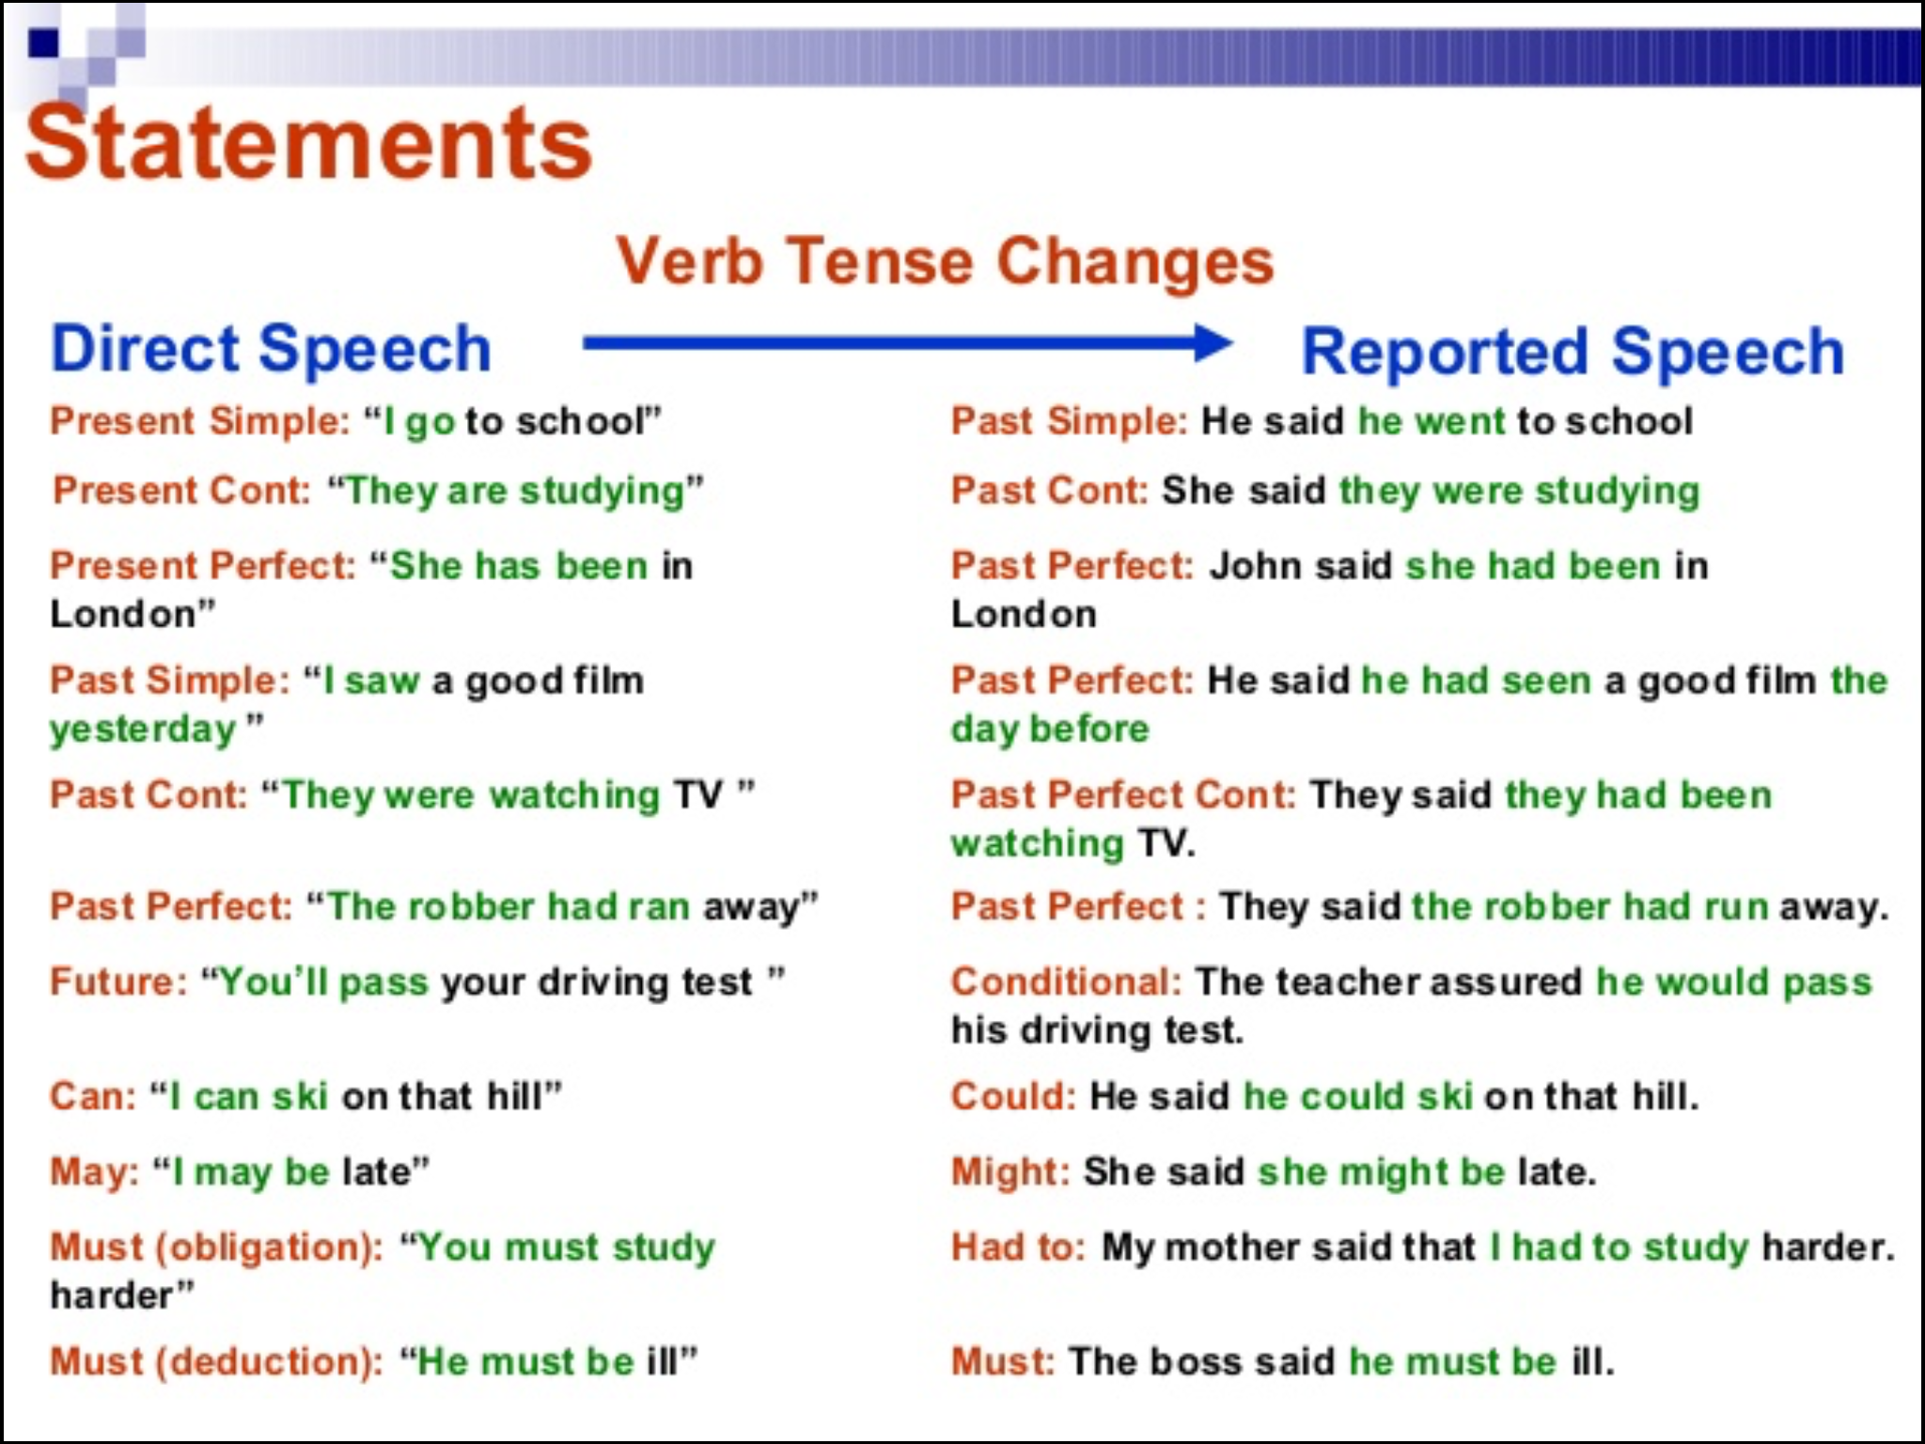

Slide 10
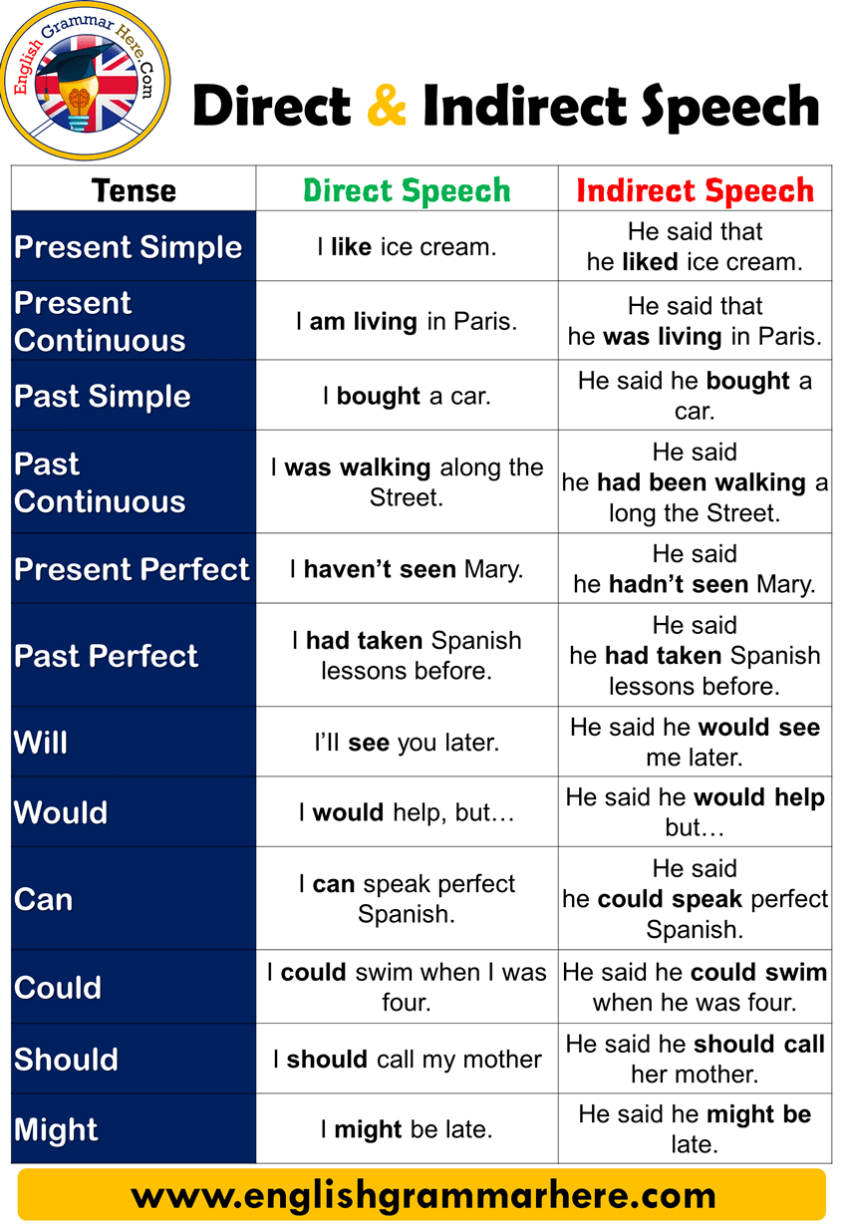

Slide 11
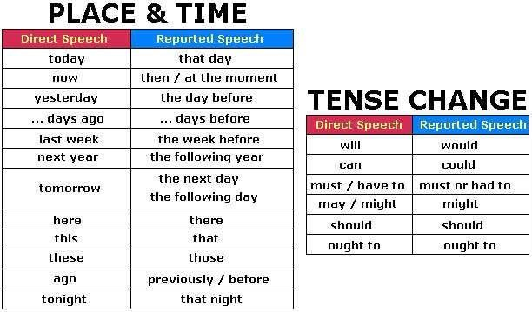

Slide 12
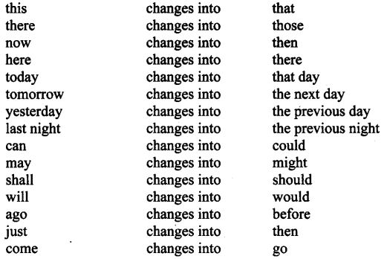

Slide 13
Some examples
DIRECT SPEECH
INDIRECT SPEECH
I said, “My mother cooks well.”
She said, “I am reading a novel now.”
He said, “I killed an ant.”
We said, “They have done their job.”
I said that my mother cooked well.
She said that she was reading a novel then.
He said that he had killed an ant.
We said that they had done their job.

Slide 14
Direct Speech
Indirect Speech
She said, “ We were all laughing uncontrollably.”
He said, “I can do it.”
She said to me, “You may need help.”
He said, “She will do this task quickly.’
She said that they had been all laughing uncontrollably.
He said that he could do it.
She told me that I might need help.
He said that she would do that task quickly.

Slide 15
Direct speech
Indirect Speech
He said to me, “ I have often told you not to play with fire.”
“You have all done very badly!” remarked the teacher.
The teacher promised, “ If you will come before school tomorrow, I will explain it.”
He reminded me that he had often told me not to play with fire.
The teacher remarked that they had all done very badly.
The teacher promised that he would explain it they would come before school the next day.

Slide 16
Continued…
Direct Speech
Indirect Speech
The Prince said, “It gives me great pleasure to be here this evening.”
He said, “I shall go as soon as it is possible.”
He said, “ I do not wish to see any of you; go away.”
The prince said that it gave him great pleasure to be there that evening.
He said that he would go as soon as it was possible.
He said that he did not wish to see any of them and ordered them to go away.

Slide 17
Questions or interrogative sentences
Interrogative sentences are of two types as indicated below:
1. yes /No Questions (Those questions that can be answered in yes or no are known as yes/no questions.)
2. Wh Questions (Those questions which begin with Wh words such as; Who, what, when, where, etc, and how are also treated as wh questions)

Slide 18
Yes/No questions needed if or whether words act as a conjunction to join reporting speech and reported speech. Whereas Wh questions need nothing as they act as a conjunction in Indirect Speech. For example:
He said to me, “Are you a student?”
-He asked me if (or Whether)I was a student. Here if or whether acts as a conjunction and not as a question word.
He said to me, “What are you doing?” can be changed to the Indirect speech as; He asked me what I was doing.
Note that wh-word what itself functions as a conjunction here, no extra word has been inserted to join the two sentences.

Slide 19
Exercises on Interrogative sentences
Direct Speech
Indirect Speech
“Where do you live?”asked the stranger.
He said, “Will you listen to such a man?”
“What do you want?” he said to her.
He said, “ How’s your father?”
The stranger asked where I lived.
He asked them if they would listen to such a man.
He asked her what she wanted.
He asked how her/his father was.

Slide 20
Continued…
Direct Speech
Indirect
“Are you coming home with me?” he asked.
“which way did she go?” asked the young man.
“Have you anything to say on behalf of the prisoner?” said the judge finally.
He asked if she/he was going home with him
The young man asked which way she had gone.
The judge finally asked if he/she had anything to say on behalf of the prisoner.

Slide 21
LETS PRACTICE!!!

Slide 22
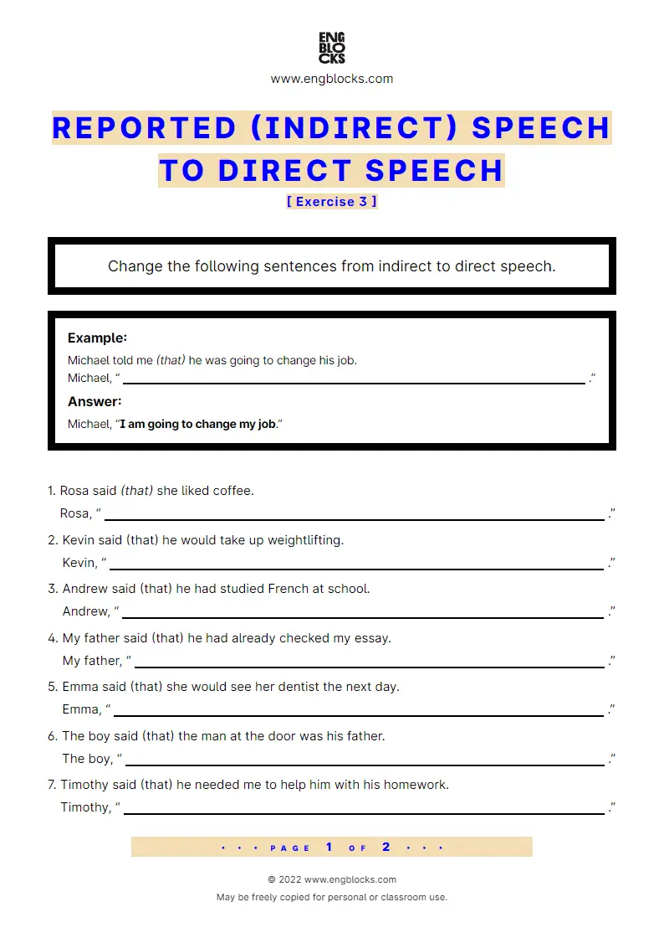

Slide 23
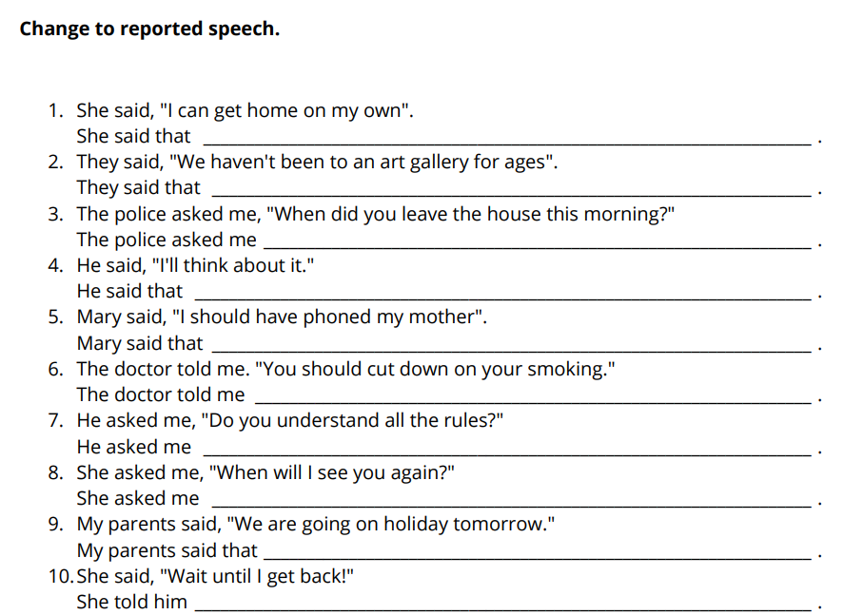

Slide 24
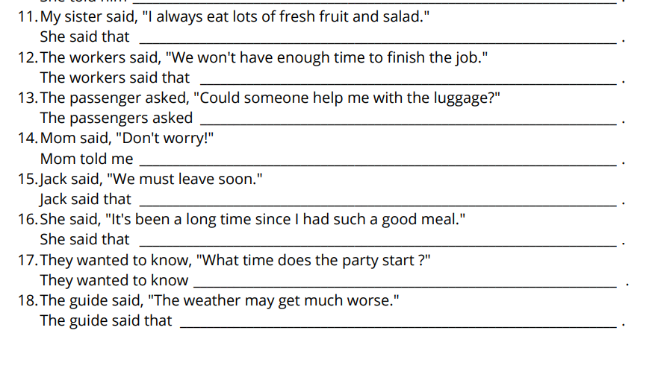

Slide 25
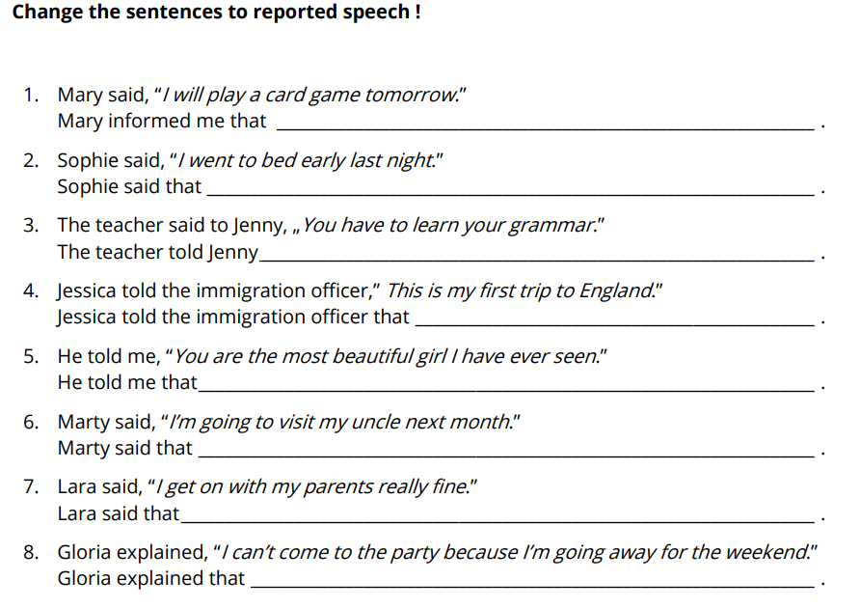

Slide 26
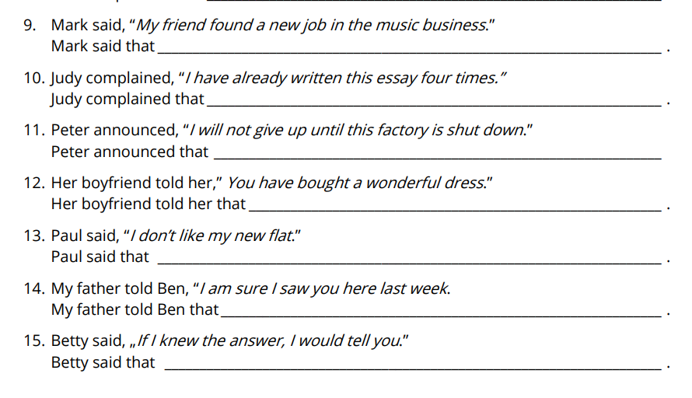

Slide 27
THANK YOU!

